Slide 1


AgriSure App
An app for farmers to sign up with FPOs to have transparency of information.
A Software Approach to Enhancing Agriculture on a budget
Team Equators
Aaditya Rengarajan
Kavin Dev R
AgriSure NABARD Hackathon

Slide 2
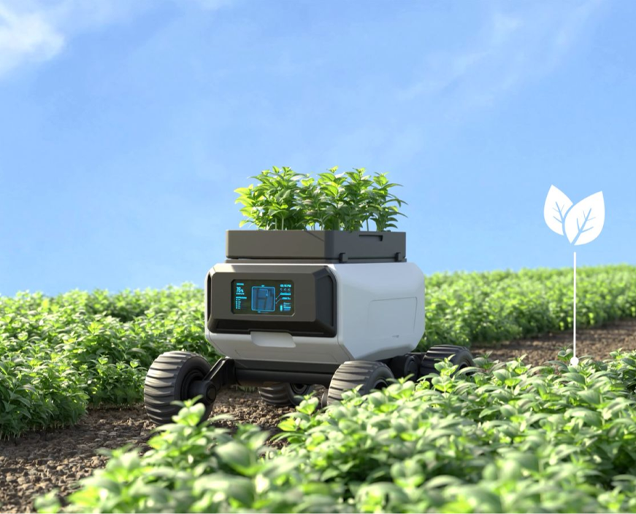
AgriSure App
PROBLEM STATEMENT
AgriSure
Greenathon
Farmers often face challenges due to a lack of organized systems for coordinating their agricultural activities with Farmer Producer Organizations (FPOs) and Cluster-Based Business Organizations (CBBOs).
The high cost of smart agriculture technologies, like advanced sensors and data analysis platforms, creates a barrier to entry for small and marginal farmers.
Clarity in problem statement acquired through sessions of interviews with Professors of Agriculture from IIIT-Bangalore and other Governmental institutions, as well as low to medium scale farmers and farm owners.
streamline communication and coordination between farmers and FPOs/CBBOs, enhancing resource management, market access, and transparency.

Slide 3
Javascript
React
AGRISURE APP
Technology
Stack
ABOUT US
User Interface
Mulang Course
Partner
HTML
CSS, JS
The technology stack encompasses a backend built with React for interactive user interfaces. Front-end development is handled using HTML, CSS, and JavaScript to create and style user interfaces.
wx-radar, Web Scraping modules and the Indian Meteorological Department website assist fetching live weather data from the nearest weather station.
Latest/Live Satellite Imagery is fetched from ISRO’s NRSC’s Bhoonidhi portal.
Live data input and output are managed using JSON, and the database is backed by NoSQL MongoDB’s BSON schema, very similar to JSON.
This stack ensures secure, interactive web/native applications with real-time data processing capabilities.
Python
wx-radar
User Interface
API
IMD
Live Weather
Data
Live Weather
Data
Python
bs4
JSON
Data
API
NRSC-Bhoonidhi
Web Scraping for Live Data
Live Data
Input/Output
Remote Sensing
Imagery

Slide 4
AgriSure
App
APP DEMO
Live Demo of
App Prototype

